Slide 1

Course Overview
19CSE201 Advanced Programming
Lecture 1

Slide 2
Course Details
Course Code :- 19CSE201
Course Title :- Advanced Programming
Course L-T-P :- 2-0-3-3
Course Credits :- 3
Course Type :- Lab Based Course (70:30)

Slide 3
Course Instructors
Name of Faculty | Batch | E-mail ID | Ph. No.
Mr Sarath S | CSE B CSE E | saraths@am.amrita.edu | 9645656698
Ms Sethulekshmi U S | CSE A CSE D | sethuleksmius@am.amrita.edu | 9562334510
Ms Parvathy R | CSE C | parvathyr@am.amrita.edu | 9496329375

Slide 4
Course Timings
Live Classes
Time table

Slide 5
Course Page Link
https://amritauniv.sharepoint.com/sites/saraths/SitePages/19CSE201-Advanced-Programming.aspx

Slide 6
Course Objective
This is an undergraduate level course aims to improve the problem solving and programming skill of the students. They will learn advanced programming techniques like template programming using C++ programming language. Also, they will learn problem solving techniques like divide and conquer, greedy, and dynamic programming.

Slide 7
Course Outcomes
CO1: | Describe the object-oriented programming approach in connection with C++ and apply the STL library for problem solving.
CO2: | Students will be able to Solve recurrence equations using Iteration method, recursion tree method and Master’s Theorem
CO3: | Students will be able to design algorithms using Divide and Conquer strategy
CO4: | Learn greedy design method and students will be able to design Greedy algorithms.
CO5: | Learn Dynamic Programming design method and students will be able to design DP algorithms for problems.

Slide 8
Syllabus
Unit | Content
Unit 1 | Introduction to object programming essentials, Introduction to C++: Input, output, defining class, class instantiation and invoking member functions, constructors. C++ STL (Standard Template Library) covering popular commonly used algorithms and data structures like arrays, vectors, deque, queue, priority queue, stack, set, map
Unit 2 | Master’s method for Divide and conquer, binary search, finding max and second max, merge sort, quick sort, quick select, maximum sum sub-array, multiplying large integers.
Unit 3 | Greedy method: fractional knapsack, task scheduling, maximum sum sub-sequence, Dynamic programming: LIS, LCS, edit distance, knapsack, subset sum

Slide 9
Text Books/References
Reference(s)
C++ Programming Language by Bjarne Stroustrup
Introduction to Algorithms by Thomas H. Cormen, Charles E. Leiserson, Ronald L. Rivest, and Clifford Stein.
Using the C++ Standard Template Libraries, Ivor Horton
Competitive Programmer’s Handbook by Antti Laaksonen.

Slide 10
Course Evaluation Policy

Slide 11
Why C++?
Popular and relevant (used in nearly every application domain):
end-user applications (Word, Excel, PowerPoint, Photoshop, Acrobat, Quicken, games)
operating systems (Windows 9x, NT, XP; IBM’s K42; some Apple OS X)
large-scale web servers/apps (Amazon, Google)
central database control (Israel’s census bureau; Amadeus; Morgan-Stanley financial modeling)
communications (Alcatel; Nokia; 800 telephone numbers; major transmission nodes in Germany and France)
numerical computation / graphics (Maya)
device drivers under real-time constraints
Stable, compatible, scalable

Slide 12
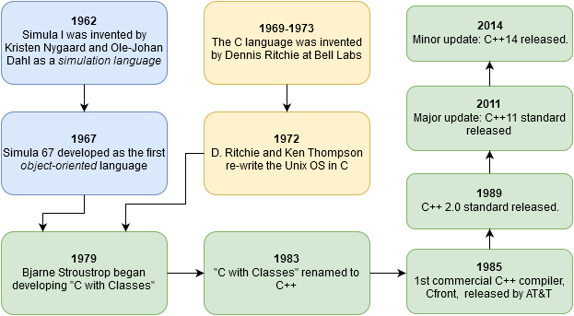

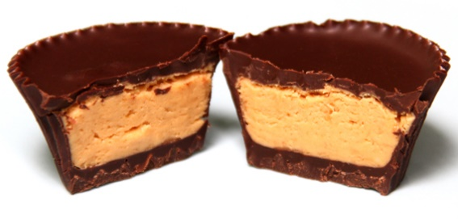
Very brief history of C++
2017
December: C++ 17 final update
Simula 67
C
For details more check out A History of C++: 1979−1991
C++
Quote: “C++ was designed to provide Simula’s facilities for program organization together with C’s efficiency and flexibility for systems programming. It was intended to deliver that to real projects within half a year of the idea. It succeeded.”

Slide 13
Characteristics of C++
“Actually I made up the term ‘object-oriented’, and I can tell you I did not have C++ in mind.”
– Alan Kay (helped invent OO programming, the Smalltalk language, and the GUI)
C++ is…
Compiled.
A separate program, the compiler, is used to turn C++ source code into a form directly executed by the CPU.
Strongly typed and unsafe
Conversions between variable types must be made by the programmer (strong typing) but can be circumvented when needed (unsafe)
C compatible
call C libraries directly and C code is nearly 100% valid C++ code.
Capable of very high performance
The programmer has a very large amount of control over the program execution
Object oriented
With support for many programming styles (procedural, functional, etc.)
No automatic memory management
The programmer is in control of memory usage

Slide 14
When to choose C++
Despite its many competitors C++ has remained popular for ~30 years and will continue to be so in the foreseeable future.
Why?
Complex problems and programs can be effectively implemented
OOP works in the real world!
No other language quite matches C++’s combination of performance, expressiveness, and ability to handle complex programs.
Choose C++ when:
Program performance matters
Dealing with large amounts of data, multiple CPUs, complex algorithms, etc.
Programmer productivity is less important
It is faster to produce working code in Python, R, Matlab or other scripting languages!
The programming language itself can help organize your code
Ex. In C++ your objects can closely model elements of your problem
Access to libraries
Ex. Nvidia’s CUDA Thrust library for GPUs
Your group uses it already!
“If you’re not at all interested in performance, shouldn’t you be in the Python room down the hall?”
― Scott Meyers (author of Effective Modern C++)

Slide 15
C vs. C++
C++ is C incremented (orig., “C with classes”)
C++ is more expressive (fewer C++ source lines needed than C source lines for same program)
C++ is just as permissive (anything you can do in C can also be done in C++)
C++ can be just as efficient (most C++ expressions need no run-time support;
C++ is more maintainable
(1000 lines of code – even brute force, spaghetti code will work; 100,000 lines of code – need good structure, or new errors will be introduced as quickly as old errors are removed)

Slide 16
Design goals of C++
Backward compatibility with C (almost completely – every program in K&R is a C++ program – but additional keywords can cause problems)
Simplicity, elegance (few built-in data types, e.g., no matrices)
Support for user-defined data types (act like built-in types; N.B. Standard Template Library (STL))
No compromise in efficiency, run-time or memory (unless “advanced features” used)
Compilation analysis to prevent accidental corruption of data (type-checking and data hiding)
Support object-oriented style of programming

Slide 17
Learning C++
Goal: Don’t just learn new syntax, but become a better programmer and designer; learn new and better ways of building systems
Be willing to learn C++’s style; don’t force another style into it
C++ supports gradual learning
Use what you know
As you learn new features and techniques, add those tools to your toolbox
C++ supports variety of programming paradigms

Slide 18
Programming paradigms
procedural – implement algorithms via functions (variables, functions, etc.)
modular – partition program into modules (separate compilation)
object-oriented – divide problem into classes (data hiding, inheritance)
abstract – separate interface from implementation (abstract classes)
generic – manipulate arbitrary data types (STL: containers, algorithms)

Slide 19

What is object-oriented?
Encapsulation “black box” – internal data hidden
Inheritance related classes share implementation and/or interface
Polymorphism ability to use a class without knowing its type
© SDC
“C++ is an object-oriented language” = C++ provides mechanisms that support object-oriented style of programming

Slide 20
Some C++ concepts
constructor / destructor / copy constructor
initialization list
inheritance
exceptions
overloading operators (e.g., assignment operator)
namespace
const
virtual function
pure virtual (abstract) function
friend
template
standard template library (STL)
pass by value, pass by reference
composition versus derivation

